Slide 1
Optimizing Hotel Room Pricing for Revenue Maximization
Presented By: Ashish Kumar Mishra
Location: Gorakhpur, UP

Slide 2
EXECUTIVE SUMMARY
Purpose: To optimize the pricing strategy of Azure Hotels, maximizing revenue and improving profitability through advanced data analytics.
Key Findings:
-> Identified four distinct customer segments with varied booking behaviors.
-> Key pricing drivers include lead time, booking cancellations, and seasonal demand.
-> Proposed pricing strategy expected to increase revenue by 3% year-over-year.
Recommendations: Implement a dynamic pricing model tailored to customer segments and seasonal trends.

Slide 3
BUSINESS CONTEXT
01
02
03
About Azure Hotels
Current Challenges
A leading hospitality chain with 50 hotels across 20 major cities in the United States, offering a spectrum from budget rooms to luxury suites.
->Inconsistent room pricing across markets
->Increasing competition
Project Objective
Develop a data-driven pricing strategy that adapts to market dynamics and customer preferences.

Slide 4
DATA OVERVIEW
01
02
03
DATA SOURCES
DATA CHALLENGES
DATA PREPARATION
Room bookings and cancellations data from the past two years.
Competitor pricing and market trend analysis.
Customer feedback and demographic information.
Significant missing data in booking cancellations.
Inconsistent data collection across sources.
Imputation of missing values based on median strategies.
Standardization of data for clustering analysis.

Slide 5
CUSTOM SEGMENT ANALYSIS
Utilized K-means clustering to segment customers based on booking patterns and demographics.

Slide 6
Segment Profiles:
->Business Travelers: High frequency of bookings, minimal cancellations, short stays.
->Leisure Travelers: Longer stays, often booked in advance, higher special requests.
->Budget Conscious: Highly sensitive to pricing, frequent users of promotions.
->Luxury Seekers: Low sensitivity to price, high demand for special services.
Visuals: Pie charts of segment proportions and bar graphs showing average revenue per segment.

Slide 7
PRICING DRIVERS IDENTIFICATION
LEAD TIME
SEASONALITY
MARKET TRENDS
Longer lead times associated with lower prices.
Higher prices during peak tourist seasons.
Alignment with competitor pricing strategies.

Slide 8
Pricing Strategy Development
Demand Forecasting
Segment-Based Pricing
Use machine learning models to predict high demand periods and adjust prices accordingly.
Customize pricing strategies tailored to the booking habits and price sensitivity of each segment.

Slide 9
Impact Quantification
Expected Financial Impact
Risk Assessment
Projected increase in annual revenue of 3%.
Enhanced room occupancy rates by 5% during traditionally low seasons.
Potential customer pushback in highly sensitive segments.
Monitoring and adjustments will be necessary to refine pricing models.

Slide 10
CONCLUSION AND NEXT STEPS
SUMMARY
The proposed dynamic pricing strategy aligns Azure Hotels' pricing with market conditions and customer behaviors, promising significant improvements in revenue and market share.

Slide 11

Implementation Steps
Pilot the strategy in select markets.
Continuous monitoring and real-time adjustments.
Full rollout post three-month evaluation.

Slide 12

Future Considerations
Explore AI-driven dynamic pricing tools for real-time pricing adjustments.

Slide 13
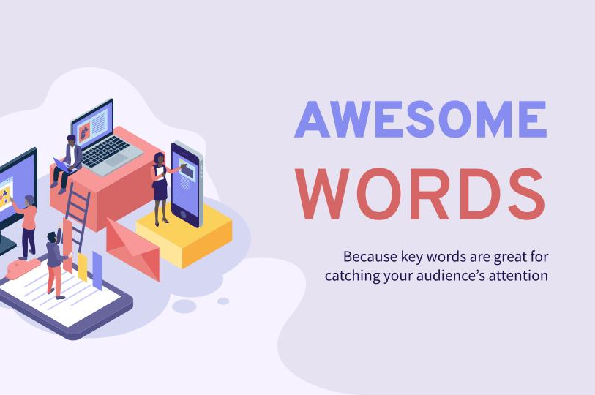
IMPLEMENTATION: JUPYTER NOTEBOOK

Slide 14

Q&A

Slide 15

-> Interactive Session: Floor for questions. -> Contact Information: ashishmishra19122000@gmail.com

Slide 16
THANKS

